Slide 1
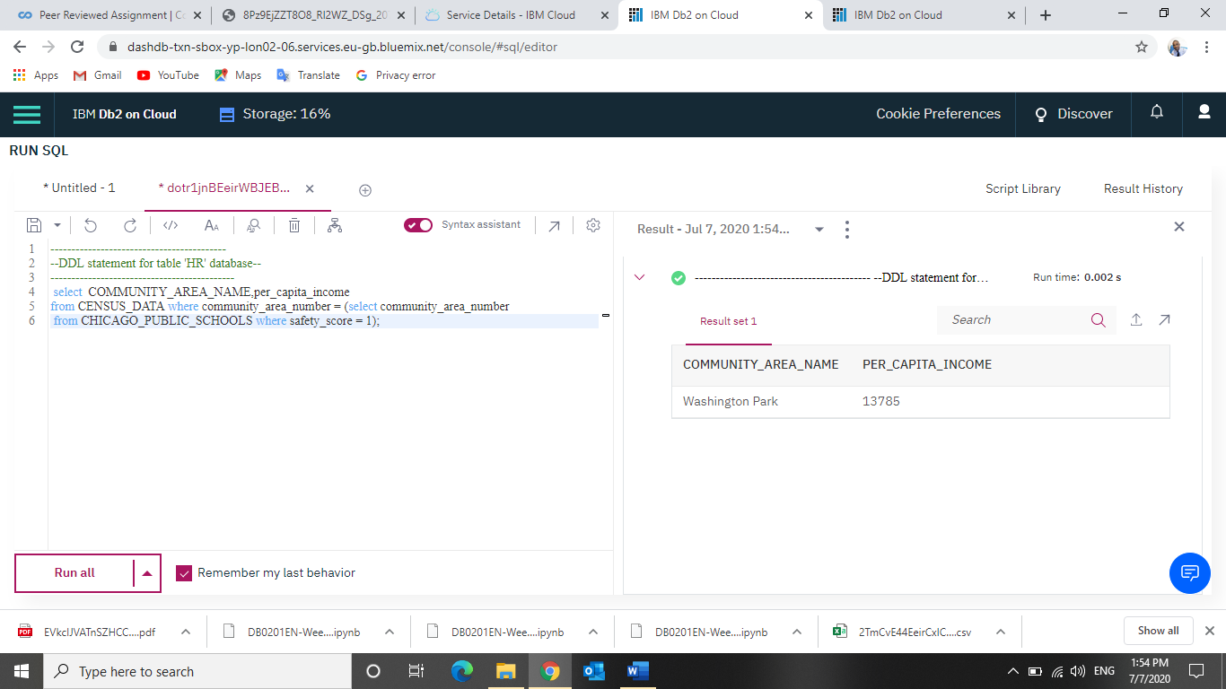
Project to Display a Community Data Analysis and History using SQL queries on the IBM DB2 on cloud. Name:Igbinedion Michael Iyobosa Date:7/7/2020

Slide 2
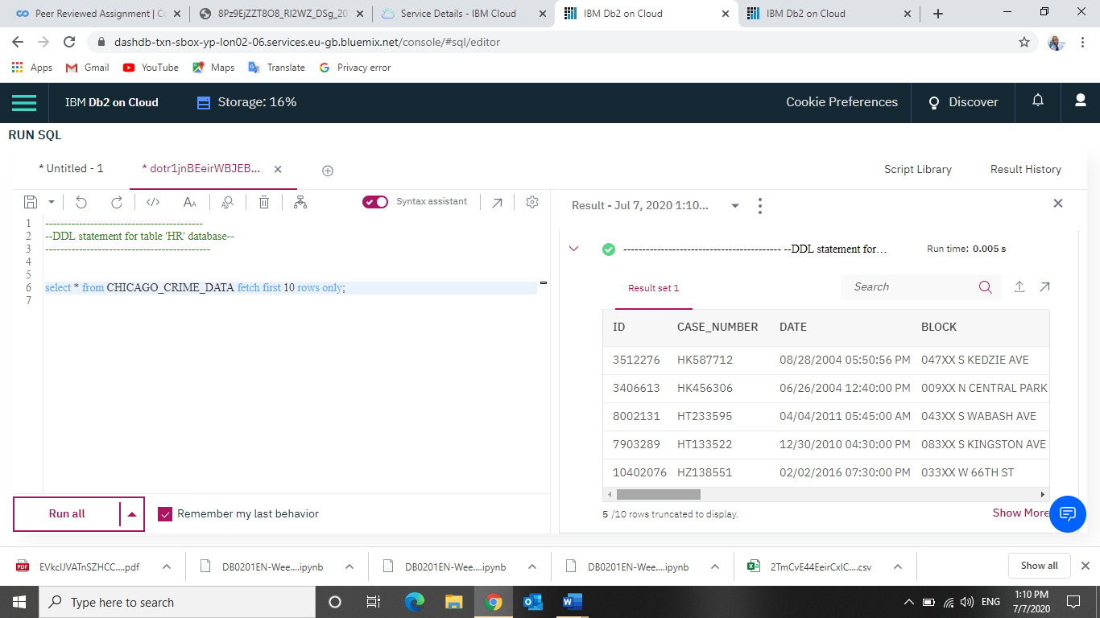

Slide 3
